Slide 1

PROJECT A
OS & networking
By: Elaine R Constancio

Slide 2


Executive summary
As your hired SME or subject matter expert, I’m able to help set up a very secure network, backed by our company’s experience and my knowledge of the IT system’s you require. At your initial request, we have provided you with options with a new network that gives you more space on a budget! We’ve implemented virtual machines instead of costly hardware to help you invest that hard earned cash on more things that matter, like coffee for your excited new clients.
We were also able to meet and exceed these operational costs by installing a new firewall, a PC for the CEO, a Webserver, DNS Server (dedicated to your www.seclab.net domain), and some easy-to-use Linux machines for monitoring and conducting cybersecurity related tasks on this new awesome network we built you!

Slide 3

Network diagram
Here is the network diagram which shows the new network we have implemented for your business. As you can see, we’ve installed 3 network segments. You’re PC (LAN) which connects thru your Router FW instead of directly to the internet and has a Kali Linux virtual machine installed on your same network. Then we have the DMZ network segment which means A demilitarized zone (DMZ) which is a perimeter network that protects an organization's internal local-area network (LAN) from untrusted traffic. These servers and resources are isolated and given limited access to the LAN to ensure they can be accessed via the internet, but the internal LAN cannot. Thus, providing a more secure network on top of the router Firewall. Finally, we have added a network segment to the internet directly thru the Router FW which also include a Kali Linux Virtual Machine.

Slide 4
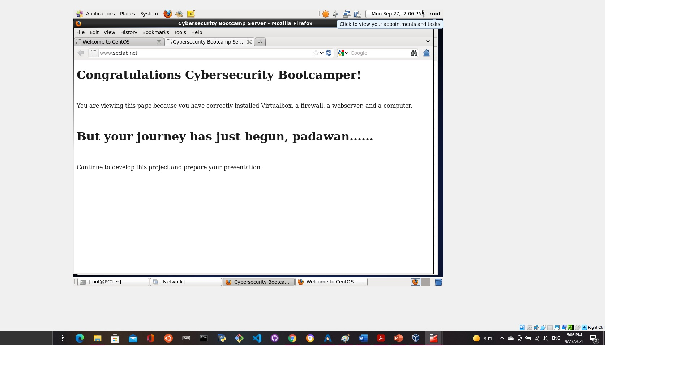
Connecting safely to the Seclab.com domain
As you can see, we have successfully connected you to the internet on your network protected by a firewall.

Slide 5
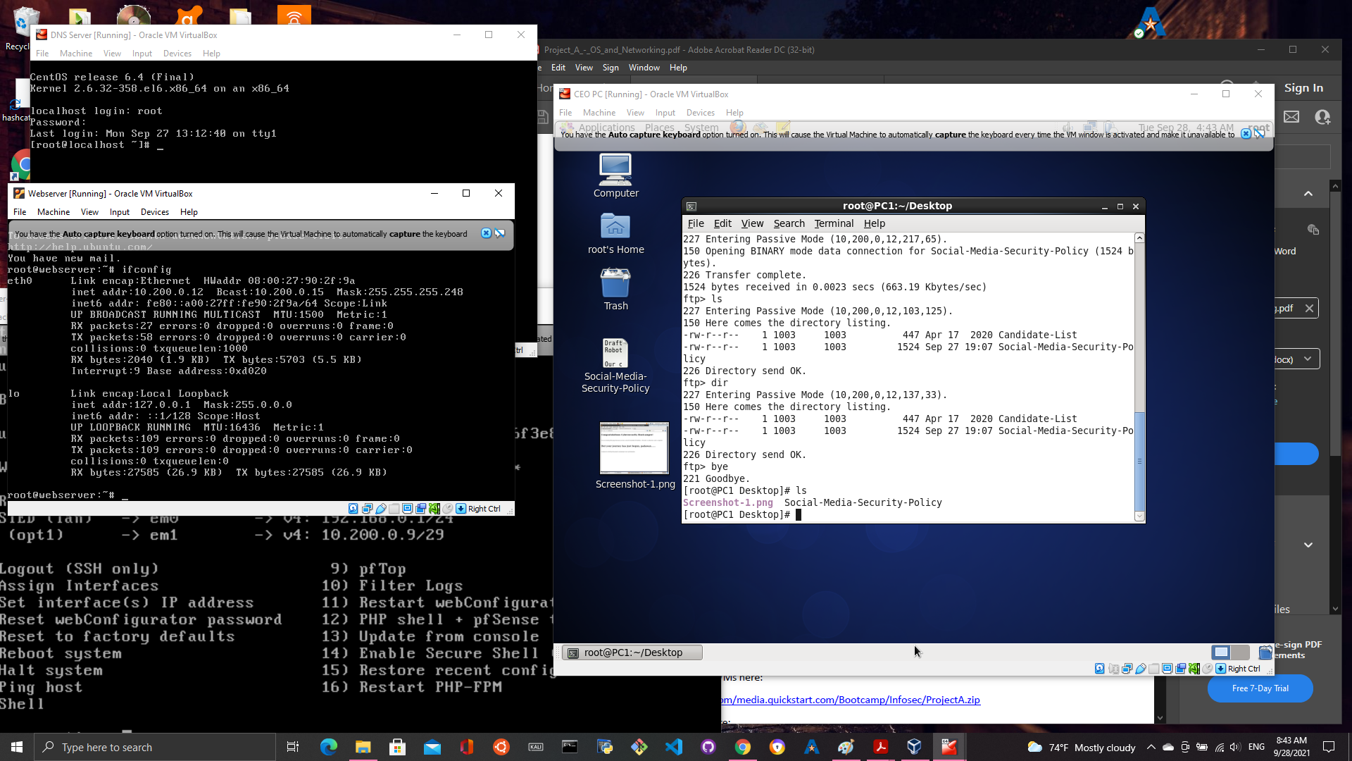
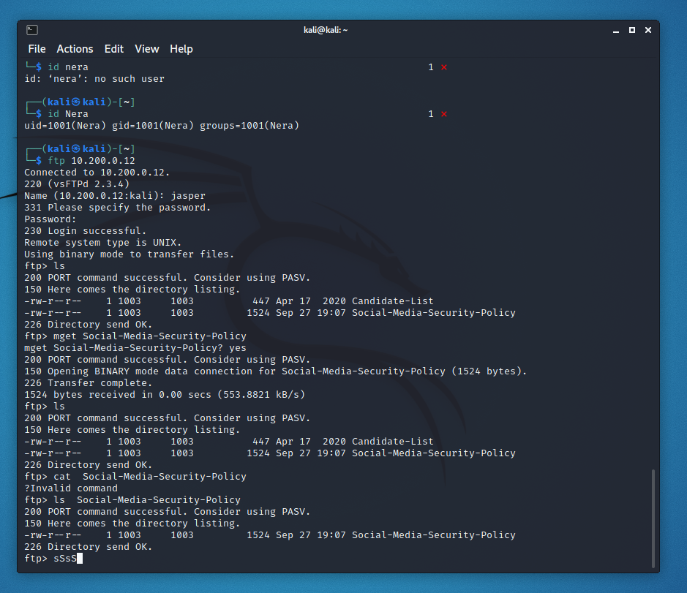
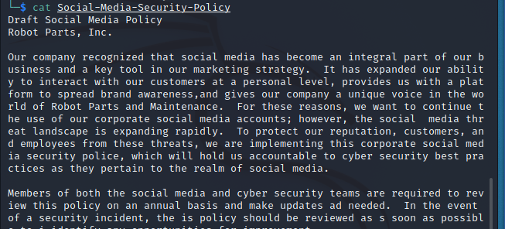
Safely transfer files (FTP)
FTP or File transfer Protocol is one of the safest ways to send or receive files within your corporation with the worry of the data being compromised or even stolen. According to www.ftptoday.com, there are 5 benefits to a FTP server, “..Security, control, large file sizes, improved workflow, and our favorite; disaster recovery.” (Horan, N.D.).
We were able to successfully download your Social-Media-Security-Policy to your Root directory in the CEO PC and on kali linux-Trusted Machine.

Slide 6
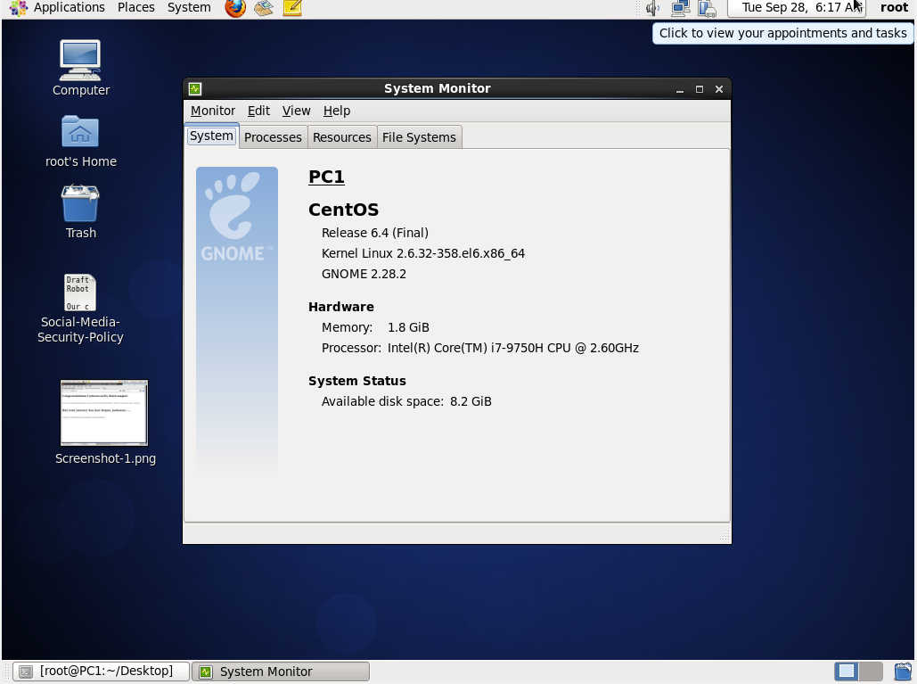
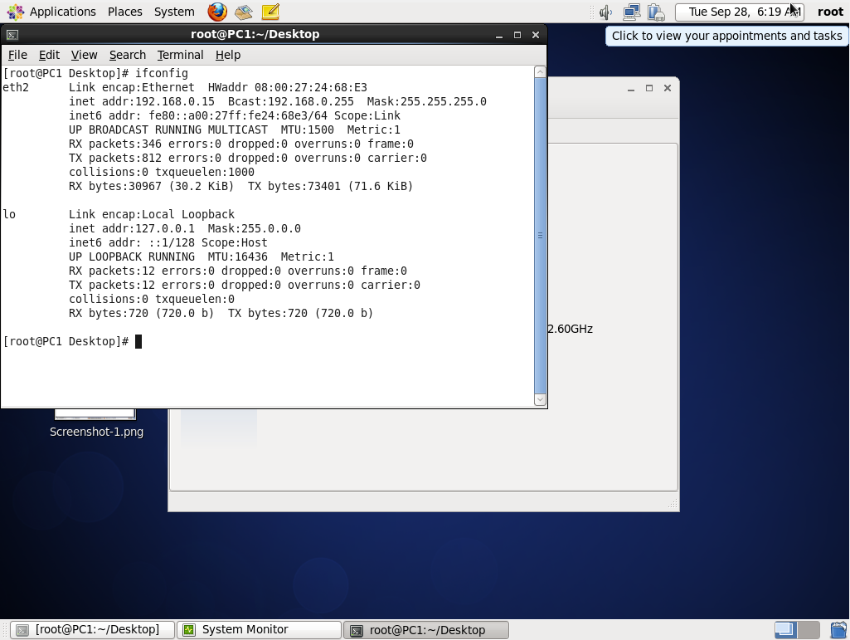
CEO PC OS & IP Configurations
As you can see in the images on the right, the CEO PC Operating System and IP configurations are as follows:
CEO PC Operating System Version: (located in About in System)
CentoS Release 6.4 (Final)
Kernal Linux 2.6.32-358.el6.x86_64
GNOME 2.28.2
Hardware:
Memory : 1.8GB
Processor: Intel® Core™ i7-9750H CPU @ 2.60GHz
System Status: Available Disk Space: 8.2 GB
IP Address: (ifconfig, hostname –I) 192.168.0.15

Slide 7
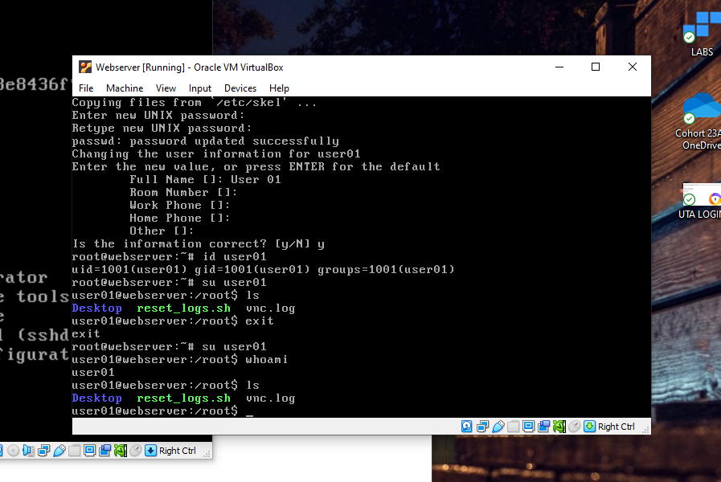
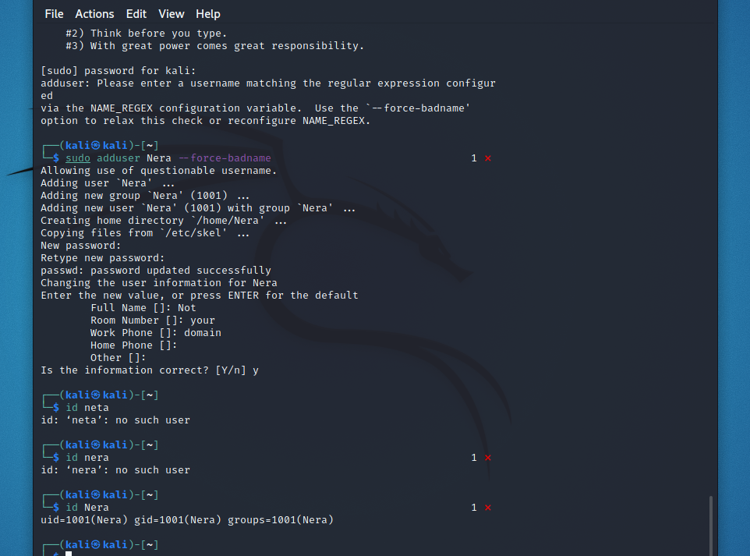
Adding a user
Successfully added a new user (user01) to the CEO pc with command line adduser user01, passwd (password).
To sign into user01: su - user01
From root which has overall authorization, the password for this account will not be required. However, accessing from accounts with less permissions, password will be required.
Also, added a new user directly in kali linux Trusted machine which also is connected to the CEO pc with command line: sudo adduser Nera –force-badname.

Slide 8
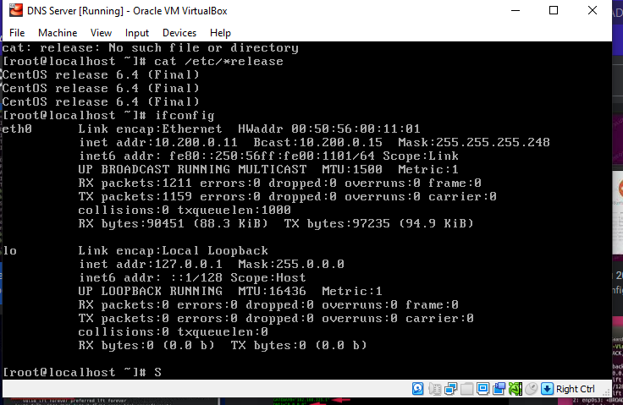
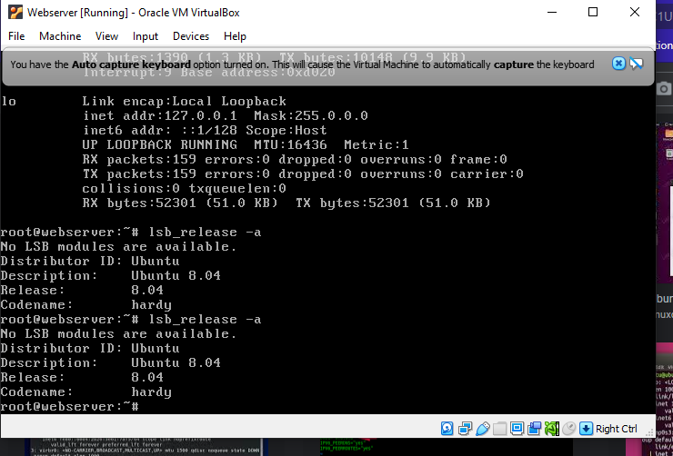
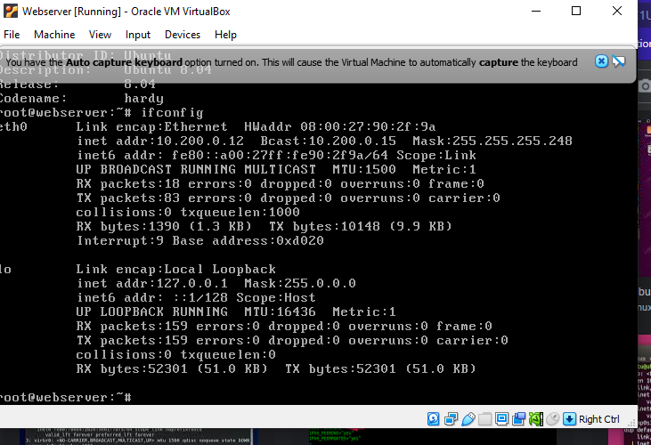
OS Version and Ip configurations for dns and web server
DNS OS version and IP configurations:
DNS OS Verrsion: (cat /etc/*release): CentOS release 6.4
DNS Server IP config: (ifconfig): 10.200.0.11
Webserver OS version and IP configurations:
Webserver OS version: (lsb_release –a) Ubuntu 8.04
Webserver IP config: 10.200.0.12

Slide 9
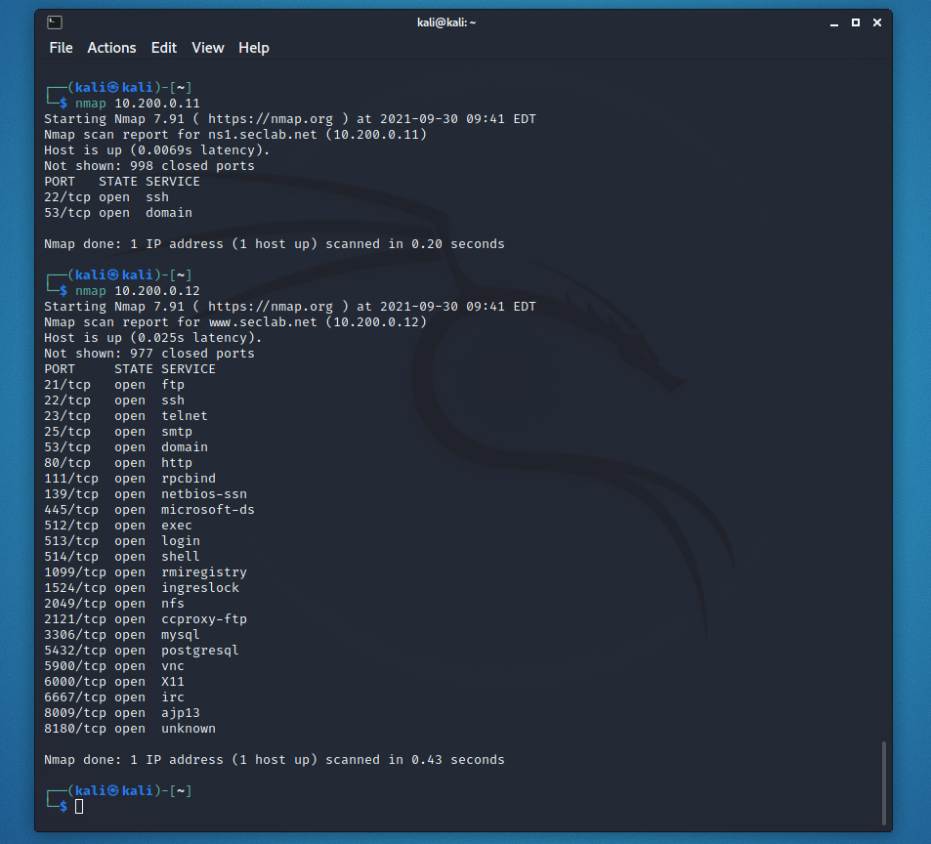
Preforming port scans
As you can see, we preformed port scans in the Kali Linux-trusted Machine for both the DNS and Webserver for any open ports.

Slide 10
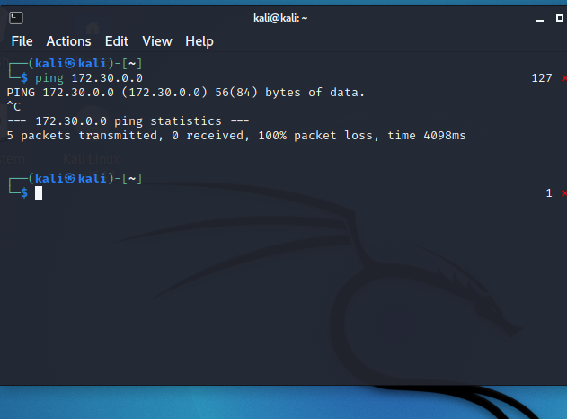
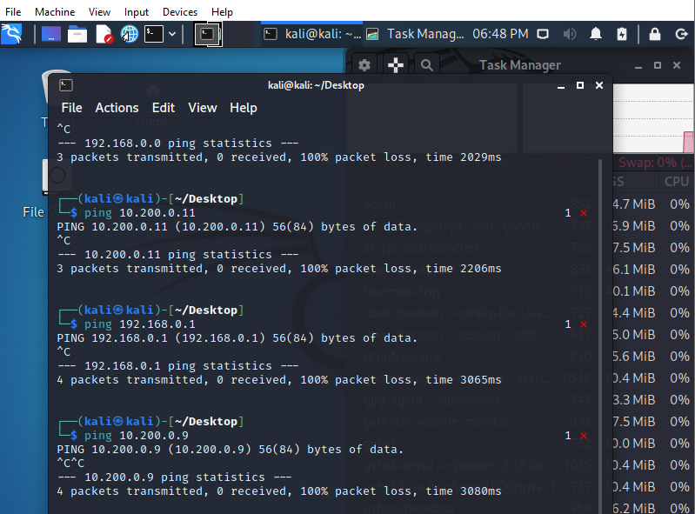
Verifying we are in a secure network
As you can see, we have tried to ping the untrusted Ip address on the kali Linux-trusted network and was unsuccessful because no data would be able to get thru the firewall in this network. Then, we tried to ping the Kali-Trusted and the DMZ network from the untrusted and was unsuccessful due to the firewalls.

Slide 11
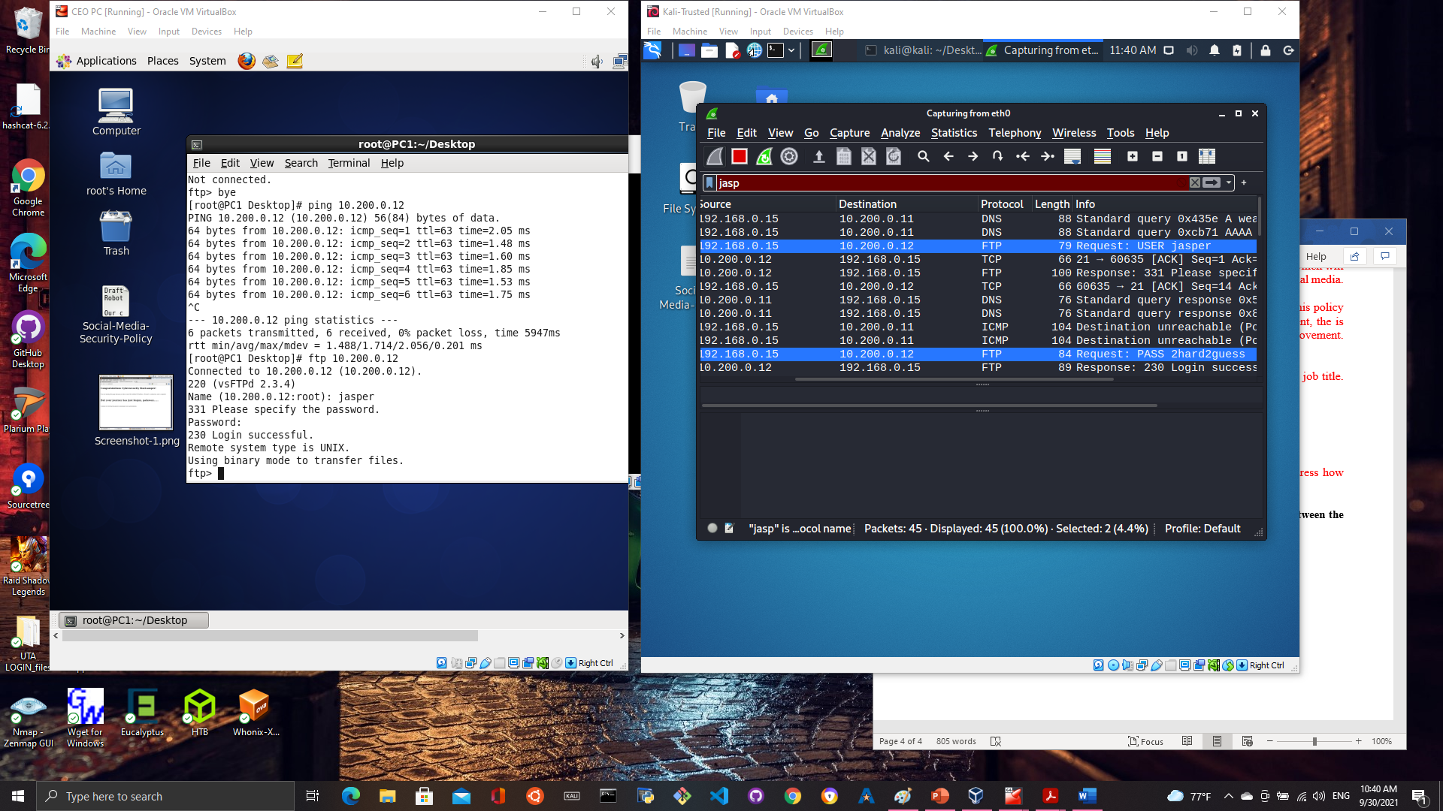
Confirming data sent thru Wireshark tool
Your system administrator will be able to monitor your website traffic and provide competent security protocols and troubleshoot the network with the useful Wireshark tool we included!

